Slide 1

Monte Carlo Cryptocurrency

Slide 2
What is a Monte Carlo Simulation?
A Monte Carlo simulation is a model used to estimate the probability of outcomes when there is randomness present
Every single simulation emulates a system or behavior and outputs the result.
The simulation is repeated many times and the results are used to estimate the probability.
For example:
Simulate playing 100 rolls of roulette (one simulation)
Repeat 100,000 times
Get the average payout out of 100k

Slide 3
Monte Carlo Cryptocurrency
Chose to look at Bitcoin due to its volatility.
One simulation is a one-year price trajectory
Look at probability of making a return
Took a time series approach and chose to build an ARMA-GARCH model based off the log returns
Then using the coefficients of the model, use it to forecast the next day’s volatility

Slide 4
ARIMA(p, d, q)
Three components:
Autoregressive - AR(p)
Predicts future values based on past values
AR(1): V_{T} = β₀ + β₁V_{t-1} + α_{t}
Integrated - I(d)
Difference of series
Used for non-stationary time series
Moving Average - MA(q)
Predicts future values based on past random shocks/errors
MA(1): V_{T} = β₀ + β₁α_{t-1} + α_{t}

Slide 5
GARCH(p, q)
Similar to the AR and MA components of ARIMA
Predicts volatility at a certain time period instead of value
Autoregressive conditional heteroskedasticity – ARCH(q)
Predicts variance of the ARIMA error term using past observations
Generalized autoregressive conditional heteroskedasticity – GARCH(p, q)
Predicts variance of the ARIMA error term using past values of variance, along with the ARCH component if q doesn't equal 0

Slide 6
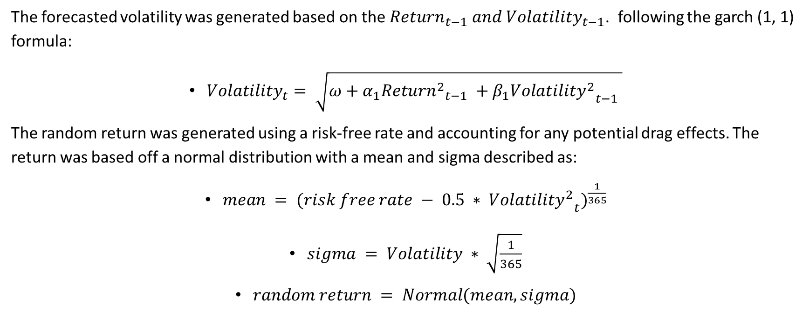
Simulating a Price Trajectory
The forecasted volatility was generated based on the $Return_{t−1} and Volatility_{t−1}$. following the garch (1, 1) formula:
$Volatility_{t}= \sqrt{ω+α_{1}Retur{n^{2}}_{t−1} +β_{1}Volatilit{y^{2}}_{t−1} }$
The random return was generated using a risk-free rate and accounting for any potential drag effects. The return was based off a normal distribution with a mean and sigma described as:
$mean = (risk free rate − 0.5 ∗ Volatilit{y^{2}}_{t})^{\frac{1}{365}}$
$sigma = Volatility ∗ \sqrt{\frac{1}{365}}$
$random return = Normal(mean, sigma)$

Slide 7
Methodology
Use auto_arima function from pmdarima package to fit an ARIMA model on the log returns of the observed series
1
Build GARCH model on the ARMA residuals using arch_model from the arch package
2
Use the fitted model’s parameters and use the garch formula to forecast the next sigma $$\sqrt{ω+α_{1}Retur{n^{2}}_{t−1} +β_{1}Volatilit{y^{2}}_{t−1} }$$
Generate a return using the forecasted sigma
Use the fitted model’s parameters and use the garch formula to forecast the next sigma √(𝜔+𝛼_1 𝑅𝑒𝑡𝑢𝑟〖𝑛^2〗_(𝑡−1) +𝛽_1 𝑉𝑜𝑙𝑎𝑡𝑖𝑙𝑖𝑡〖𝑦^2〗_(𝑡−1) )
Generate a return using the forecasted sigma
3
Repeat 365 times
4
This process was much faster (100 simulations took less than one minute)
Results appeared more in line with observed values

Slide 8
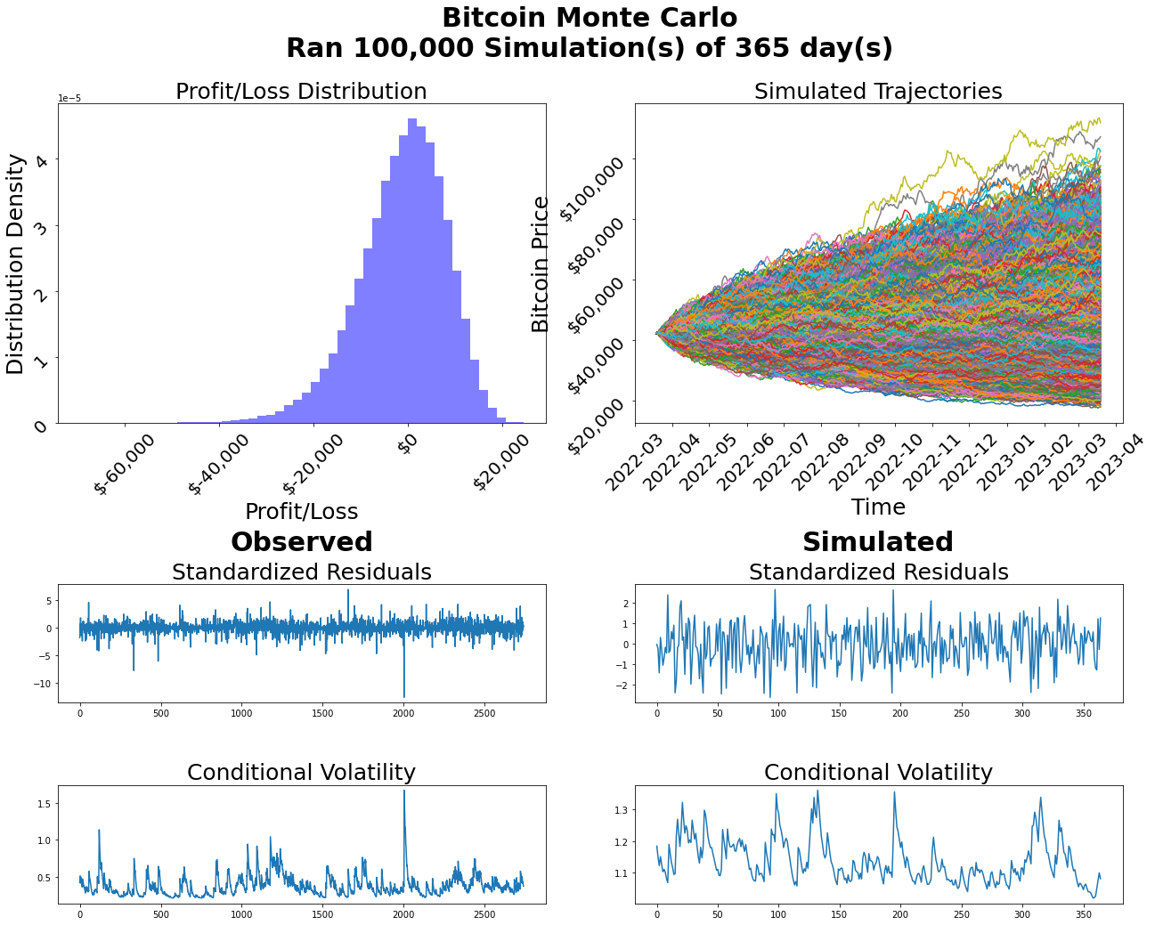
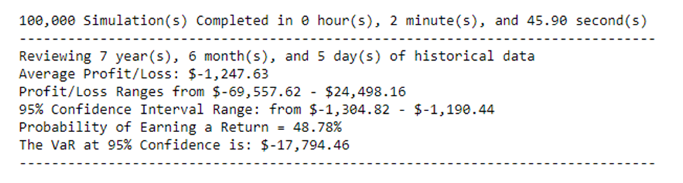
Results / Graphs

Slide 9
Conclusion
On average, investors lost money if holding Bitcoin for a year (-$1,200)
The 95% VaR is a loss of about one third of the investment or about $17k
Hold out the last year of data, run simulation for 365 days, and compare hold out to simulated results

